Slide 1
TITLE : AI Chat-Bot
AI NAME –
Chat-Bot G
NAME : GAURAV PAPNAI
COURSE : B.VOC SOFTWARE DEVELOPMENT

Slide 2
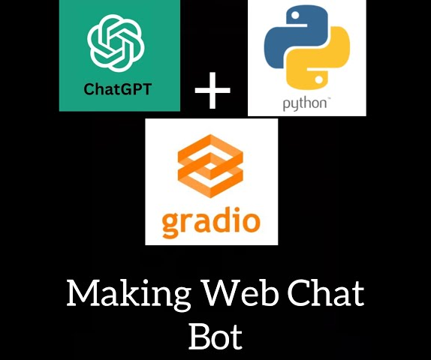
INTRODUCTION
INTRO TO THE PROJECT::
This is a Python-based AI chatbot application that uses OpenAI's GPT-3.5-turbo model and Gradio for the user interface. The chatbot can handle a wide variety of user queries and provides intelligent responses.

Slide 3
FEATURES
1
.
Chat Interface: Interact with the chatbot through a simple and clean Gradio web interface.
2
Secure API Integration: The OpenAI API key is stored securely in a config.yaml file.
3
Customizable: Easily modify the chatbot's behavior by changing the system message.
4
Easy Sharing: Share your chatbot online with Gradio's shareable link.

Slide 4
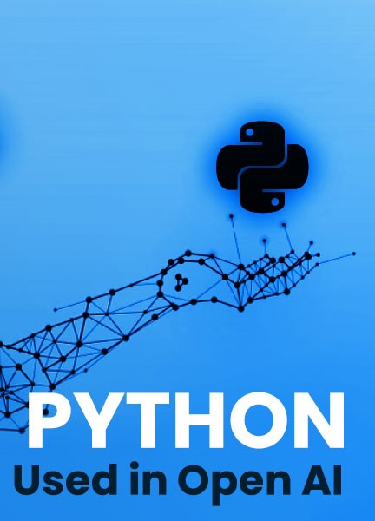
REQUIREMENTS
Before running this project, ensure you have the following:
Python 3.7 or higher
OpenAI API key (Sign up at OpenAI if you don’t have one)

Slide 5
INSTALLATION
Clone the repository: bash git clone https://github.com/gauravpapnai03/AI-chatbot-G cd ai-chatbot
Install the required Python libraries: bash pip install openai gradio pyyaml
Create a config.yaml file: In the project directory, create a config.yaml file and add your OpenAI API key: yaml api: "sk-************************************************"
Run the application: bash python app.py
1
2
Place Bet: Set a bet amount within the balance.
Spin the Reels: Reels display random symbols.
3
Win or Lose: Matches determine rewards; balance updates accordingly.

Slide 6
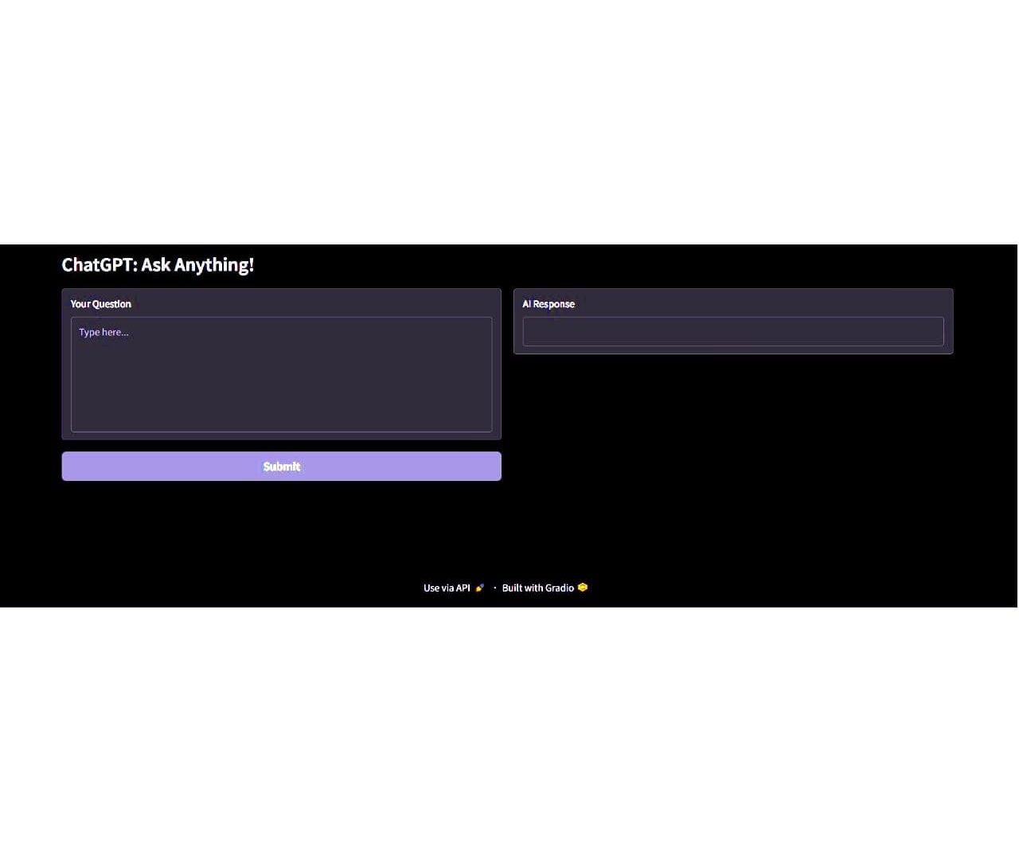
USAGE
Start the application: bash python app.py
Open the Gradio interface in your browser (a link will be provided in the terminal).
Interact with the chatbot by typing in your questions.

Slide 7


THANK YOU FOR YOUR ATTENTION

